Slide 1
Electricity
By Kurt Burgess

Slide 2
What is electricity?

Slide 3
Insulators
Some insulating materials become electrically charged when they are rubbed together. Charges that are the same repel, while unlike charges attract.
When the materials are rubbed against each other:
negatively charged particles called electrons move from one material to the other
the material that loses electrons becomes positively charged
the material that gains electrons becomes negatively charged
both materials gain an equal amount of charge, but the charges are opposite.
A charged object can be discharged by connecting it to earth with a metal wire or other conductor. If the potential difference (voltage) is very large, a spark may jump across the gap between the charged object and the conductor. This can be dangerous. For example, it could cause an explosion in a petrol station.

Slide 4
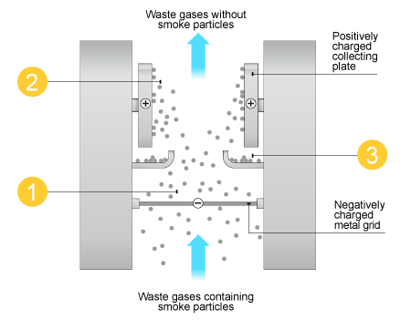
Using static electricity
Many power stations burn fossil fuels such as coal and oil. Smoke is produced when these fuels burn. Smoke comprises tiny solid particles, such as unreacted carbon, which can damage buildings and cause breathing difficulties. To avoid this, the smoke is removed from waste gases before they pass out of the chimneys. The electrostatic precipitator is the device used for this job.
The flow chart outlines how an electrostatic precipitator works.

Slide 5
Circuits
Electrical circuits can be represented by circuit diagrams. The various electrical components are shown by using standard symbols in circuit diagrams. Components can be connected in series, or in parallel.
Two things are important for a circuit to work:
there must be a complete circuit
there must be no short circuits
To check for a complete circuit, follow a wire coming out of the battery with your finger. You should be able to go out of the battery, through the lamp and back to the battery.
To check for a short circuit, see if you can find a way past the lamp without going through any other component. If you can, there is a short circuit and the lamp will not light.

Slide 6
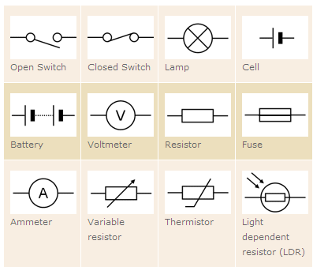
Standard circuit symbols

Slide 7
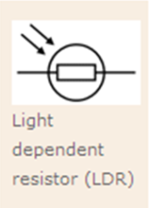
What do the symbols mean?
Light Dependent Resistors (LDR):
In bright light the resistance falls.
In darkness the resistance heightens.
This makes a useful device for various electronic circuits. EG: Automatic night lights, Burglar alarms…
Thermistor:
• Exactly

Slide 8
Voltage Current Graphs
Different resistors:
Different resistors have different resistances, hence different slopes.
Filament lamp:
As the temperature of the filament increases, the resistance increases, hence the curve.
• Diodes:
Current will only flow in one direction, as shown.
Add Voltage Current Graphs HERE:

